Slide 1
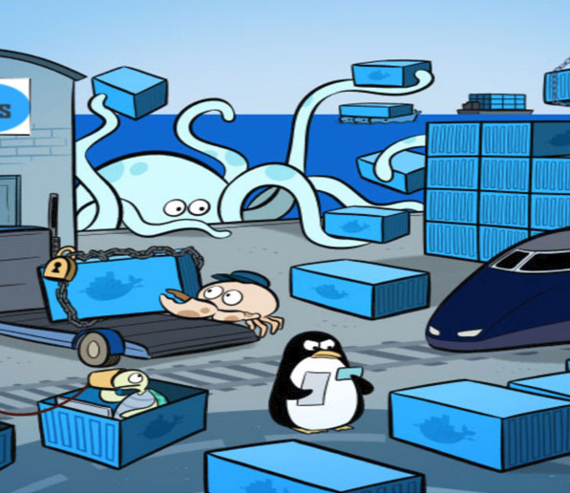
Docker Proofs of Concept
Draft Proposal

Slide 2
Introduction
Where I Tell You What I’m Going to Tell You

Slide 3
Two Phases
Phase One: Minimum Viable Product
Phase Two: Containers as a Service
Ask vendors to do a demo
Dockerize a simple app
Deploy the app
Monitor the app
Walk through NOC features
Active Directory Integration
Address our other concerns
Select a primary vendor
Figure out budgeting
Engage our vendor
Build a devops pipeline
Include multi-platform support
Extensive testing
General release

Slide 4
Phase One
Proofs of Concept and Vendor Selection

Slide 5
Consider our Resources
Who has a stake?
Who will take ownership?
Where will time come from?
How do we keep costs down?
We have some suggestions…

Slide 6
Ask Vendors to Do a Demo
We’ll present identical formal requirements to each vendor
We’ll try to get this done for free
We want it to be on our premises
We want to keep it around awhile

Slide 7
Dockerize an Application
We’ll provide a simple web application.
Include at least one dependency.
Let the vendor figure out how to make container images.

Slide 8
Deploy the Application
Let the vendor install their platform.
The application should be deployed to a Kubernetes cluster of some kind.
The application needs to be reachable and testable.
We want them to show us “the standard way” to do this stuff on their platform.

Slide 9
Monitor the Application
Show resource usage at:
The cluster level
The host level
The container level

Slide 10
Walk Through NOC Operations
Look at failover
Look at alarms
Look at some dashboards
Discuss integration with our existing NOC products
Etc…

Slide 11
Active Directory Integration
Kubernetes Cluster Security
Deployment Security
Private Container Registry Security
Etc…

Slide 12
Address our Other Concerns
How do containers make us more or less secure?
How do we scale, trend, and plan for future scale?
How do we handle change control?
How do we handle licensing and compliance?
How do we control which images are allowed?
How do we handle patching and rolling upgrades?
How do we isolate desktop machines running containers?
Etc…

Slide 13
Select A Vendor
Only consider vendors who meet all our requirements.
Consider licensing costs
Consider long-term viability
Consider usability
Consider our gut reactions
Etc…

Slide 14
Phase Two
Infrastructure Build-Out

Slide 15
Two Scenarios
Vendor Applications
Development Teams
Business and infra. applications
Need resources deployed
Workflow efficiency is good
Need minimal orchestration
Can benefit from automation
Need to support many platforms
Infrequent manual processes OK
Runs our applications
Need a pit of success to fall into
Workflow efficiency is key
Need complex orchestration
Need lots of things automated
Need to support many platforms
Need to iterate frequently

Slide 16
A Suggested Approach
Phase 1: Support Vendor Applications
Install the base platform
Begin supporting manual deployments
Roll out some kind of organizational announcement
Support auto-scaling as needed
Phase 2: Support Development Teams
Install Docker for Desktop (consider this much earlier)
Integrate devops pipelines as needed

Slide 17
Development Operations: Outer Loop
Source Control
Build
Verify
Docker Hosts
Desktop
Test Env
Private
Container
Registry
UAT Env
On-Premise
Code
Debug
Run
Validate
Off-Premise

Slide 18
Next Steps
Hint: We have a project on our hands…

Slide 19
Let’s Get Moving!
Owner: Technical Architecture Group
Driver: Eric Burcham
Core Team:
Project Manager: John Baldwin, Sara Zacharias, Jonathan Borg, Justine Gaston, Cherryl Freeman, Barry Yim
Stakeholders: Big Data, Desktop Support, Development Managers, eBusiness, Engineering, Oracle Team, SCADA, Server Team
Vendors: Docker Enterprise, Red Hat OpenShift, Rancher

